Slide 1
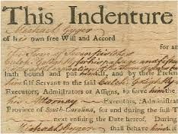
The Headright System and Indentured Servitude

Slide 2
Headright System 1618
Introduced by the Virginia Stock Company to lure settlers to Jamestown
System applied to any person who paid for their own or another's passage to Virginia would receive 50 acres of land
Land grants were initially called “plantations”
How do you think this would affect immigration?

Slide 3
Fantasies of the New World
Playwrights, poets, adventurers
Many had never seen the New World
Turned reports into fantasies of “promised land”
Told tales of fair climate, friendly natives, rich harvests, etc.

Slide 4
The Beautiful New World
1605 play in London depicting Native children who wore rubies and diamonds in their coats and caps
1606 English poet Michael Drayton called Virginia “that delicious land” rich in soil with fantastic harvests
1607 Virginia Company translates into advertisements

Slide 5
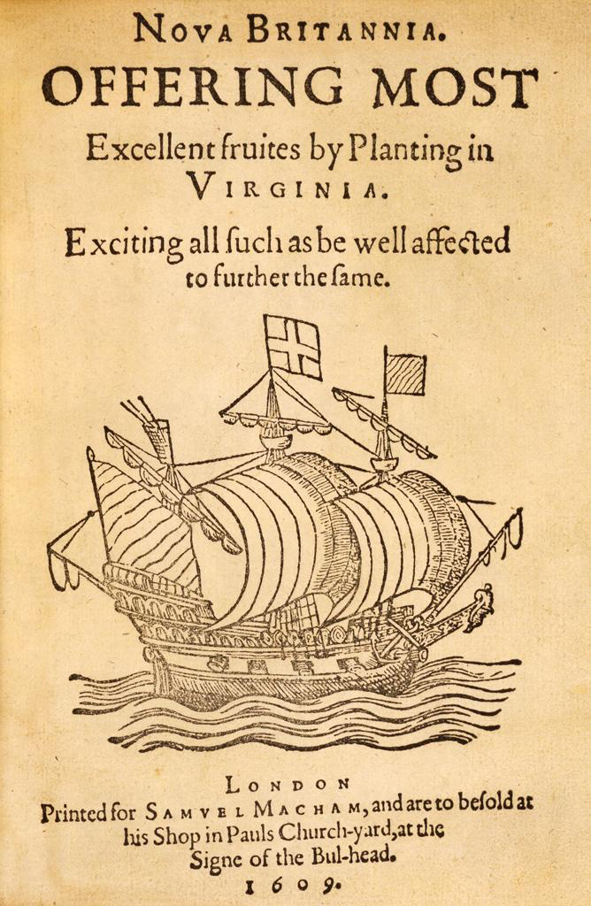
Joint Stock Advertisement
How did Joint Stock Companies take advantage of the positive publicity being printed about life in the colonies?

Slide 6
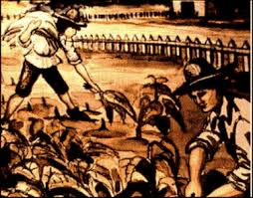
Indentured Servants
From England hired to work plantations
Promised passage to North America as well as food and shelter upon arrival
Exchanged for a limited time of servitude
Usually 4-7 years
Lower classes of English society

Slide 7
House of Burgesses
First legislature of elected representatives in the English colonies (Democratic Gov)
How democratic was it? Who do you think was allowed to vote? Who was not?
Established to encourage settlement in Virginia
Nathaniel Bacon was elected to the House of Burgesses in 1676

Slide 8
Bacons Rebellion 1676
About 1,000 Virginians broke out of control led by Bacon
Many of the rebels were frontiersmen in search of arable land
Resented Governor William Berkeley’s friendly policies towards the Natives
What is one possible reason why the Governor and the Natives had a positive relationship?

Slide 9
Bacons Rebellion 1676
Violence broke out when Berkeley refused to retaliate for a series of brutal Native attacks on the frontier settlements
Bacon and his followers violently attacked Natives both friendly and hostile
Rebels chase Berkeley out and torched Jamestown
How do you think that the average settlers in Jamestown felt following Bacons Rebellion?

Slide 10
Bacons Rebellion 1676
Bacon died suddenly of disease
Berkeley brutally crushes the uprising
Rebellion suppressed
What kinds of problems do you foresee occurring following Bacon’s Rebellion?
Notes:
Tensions remained between landless former servants and wealthier plantation owners

