Slide 1
Causes of the Great Depression
Unit 4

Slide 2
Objective & Agenda for 11/20/15
Objective
Agenda
SWBAT analyze how the actions and policies of the US Government contributed to the Great Depression
Do Now
Notes on the Causes
Occupations Activity
What Would You Do Discussion?
“BUST”
Video: America the Story of US
Discussion Questions

Slide 3
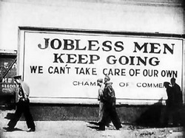
Do Now:
The American Economy went from unprecedented prosperity in the 1920s to unprecedented misery in the 1930s. It was an extraordinary reversal. Why did it occur?

Slide 4
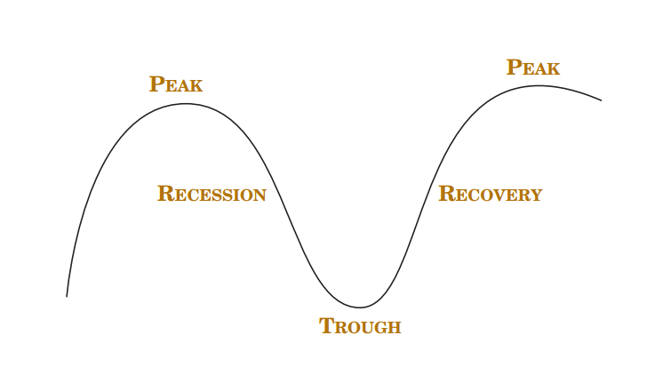
What is a Business Cycle?
Demand for durable goods falls
Demand for investment goods falls
Workers who make those goods are laid off
Because these workers now have less income, they spend less- and demand falls further
Demand for durable goods revives
Demand for investment goods revives
Workers are rehired

Slide 5
Except…
In the 1920s the demand continued to fall, business activities continued to decline and unemployment rates continued to rise.

Slide 6
Bank Failures
Federal Reserve System had been established in 1913, to prevent bank failures by lending reserves to banks that were experiencing unusually high cash withdrawals.
On the eve of the Depression, the first concern of the 12 regional Federal Reserve banks should have been the overall health of the financial system.
But the regional presidents, formerly commercial bankers hesitated to lend to banks in their districts that they considered unsound.
As a result, many banks were allowed to fail, and the failures caused fear among account holders in sound banks, prompting them to panic and withdraw their funds.

Slide 7
Bank Failures continued…
The Federal Reserve System raised interest rates in late 1931:
Discouraged business borrowing
Contracted the money supply
Banks kept some of their reserves in the form of bonds
When interest rates rise, the prices of bonds fell
Banks then held assets that have declined in value, yielding less revenue when banks sell them to raise funds to pay depositors.
The problem the Federal Reserve Banks faced is that they were obliged to follow the rules of the gold standard
Gold began to flow out of the US as a result of financial instability in foreign countries, and the reserve banks raised the interest rates that their member banks had to pay to borrow reserves
Encouraged foreign governments and individuals to buy American bonds, rather than exchanging their dollars for American gold
Raised interest rates throughout the economy, which discouraged spending by American businesses.

Slide 8
US Prosperity in the 1920s
US Prosperity in the 1920s was based on the sale of house and automobiles
Consumers for the first time could buy houses and cars on the installment plan- this led to job growth
Jobs for workers who built homes and cars
Jobs for workers who built the furniture and appliances that went into new homes
Jobs for workers who produced the steel and other materials that were used to produce cars.
Jobs for business firms who built new plants and bought new equipment to produce what consumers wanted
Jobs for workers who built and paved roads for the new automobiles
Jobs for workers in electric plants and water and sewage facilities to service the new households
The prosperity of workers in all these industirres allowed them to spend a lot of money, thus providing income to other works—income which they int turn spent to buy other goods and services.
Economists call the spread of such new spending a multiplier effect
One person’s spending becomes income to another person, who in turn can spend more and add to the income of others.

Slide 9
US Prosperity in the 1920s
Multiplier Effect in Reverse
US Business activity began to slow down by the late 1920s
The US economy entered a mild recession
Sales of homes and cars began to fall
What happened to all of the jobs that were created due to cars and homes?

Slide 10
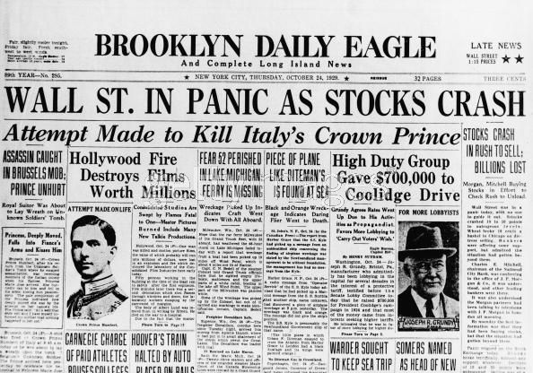
Direct Causes of the Great Depression
1. Stock Market Crash of 1929:
Although the workings of the New York Stock Exchange can be quite complex, one simple principle governs the price of stock. When investors believe a stock is a good value they are willing to pay more for a share and its value rises. When traders believe the value of a security will fall, they cannot sell it at as high of a price. If all investors try to sell their shares at once and no one is willing to buy, the value of the market shrinks.
On October 24, 1929, "BLACK THURSDAY," this massive sell-a-thon began. By the late afternoon, wealthy financiers like J.P. Morgan pooled their resources and began to buy stocks in the hopes of reversing the trend.
But the bottom fell out of the market on Tuesday, October 29. A record 16 million shares were exchanged for smaller and smaller values as the day progressed. For some stocks, no buyers could be found at any price. By the end of the day, panic had erupted, and the next few weeks continued the downward spiral. In a matter of ten short weeks the value of the entire market was cut in half. Suicide and despair swept the investing classes of America.

Slide 11
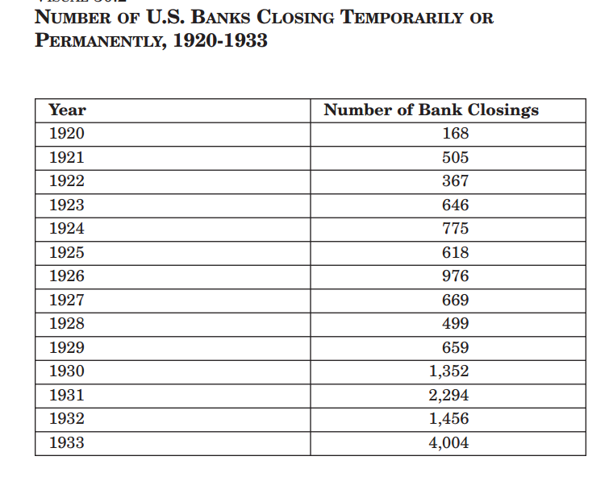
Direct Causes of the Great Depression
2. Bank Failures
Throughout the 1930s over 9,000 banks failed. Bank deposits were uninsured and thus as banks failed people simply lost their savings. Surviving banks, unsure of the economic situation and concerned for their own survival, stopped being as willing to create new loans. This exacerbated the situation leading to less and less expenditures.

Slide 12
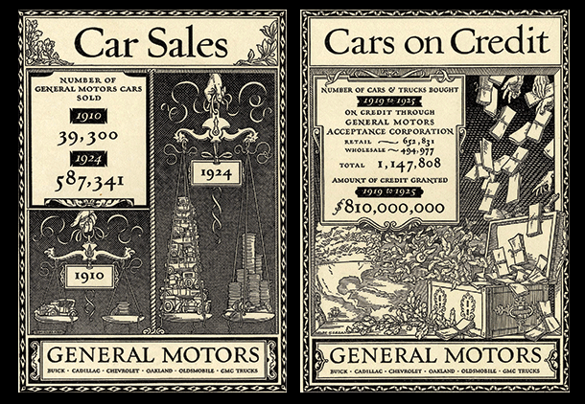
Direct Causes of the Great Depression
3. Reduction in Purchasing Across the Board
With the stock market crash and the fears of further economic woes, individuals from all classes stopped purchasing items. This then led to a reduction in the number of items produced and thus a reduction in the workforce. As people lost their jobs, they were unable to keep up with paying for items they had bought through installment plans and their items were repossessed. More and more inventory began to accumulate. The unemployment rate rose above 25% which meant, of course, even less spending to help alleviate the economic situation.

Slide 13
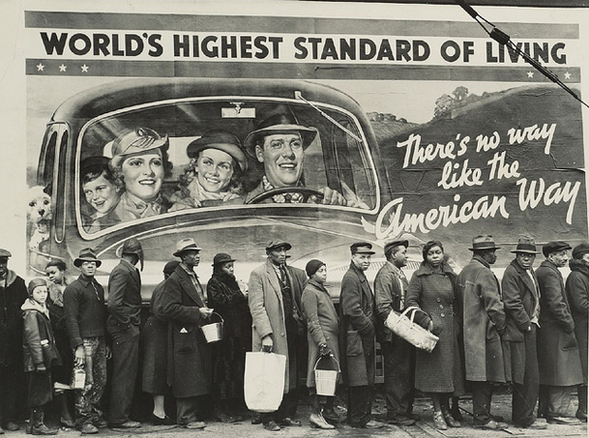
Direct Causes of the Great Depression
4. American Economic Policy with Europe
As businesses began failing, the government created the Smoot-Hawley Tariff in 1930 to help protect American companies. This charged a high tax for imports thereby leading to less trade between America and foreign countries along with some economic retaliation

Slide 14
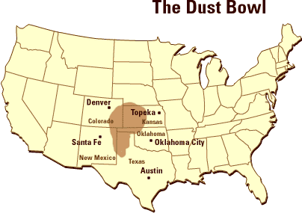
Direct Causes of the Great Depression
5. Drought Conditions
While not a direct cause of the Great Depression, the drought that occurred in the Mississippi Valley in 1930 was of such proportions that many could not even pay their taxes or other debts and had to sell their farms for no profit to themselves. The area was nicknamed "The Dust Bowl." This was the topic of John Steinbeck's The Grapes of Wrath.

Slide 15
Group Discussion: What Would You Have Done?
1.) The world financial system that emerged after World War I was based upon the gold standard. The United States and Great Britain guaranteed that they would exchange their currencies for gold at a fixed rate — $20.67 for an ounce of gold, or £4.86. Other major countries agreed to exchange their currencies for gold, dollars or pounds. In 1927, several countries, most notably Germany and Austria, experienced serious bank runs. To stabilize their currencies, they exchanged their dollars and pounds for gold. The United States experienced a serious loss of gold (as did Great Britain). To encourage foreign investors to buy American investments, the Federal Reserve Banks raised interest rates. If you were an American business owner planning to build a new factory or buy new equipment, what would you have done after interest rates were increased?
2.) The Federal Reserve lowered interest rates after a time, but in 1930 and 1931, when the American economy had already taken a downturn, more bank runs occurred in many countries, and again gold flowed out of the United States. To keep gold in the United States, the Federal Reserve Banks again raised interest rates. What was the result?
3.) Now imagine that you are an American citizen with a bank account. You read the newspapers. You see that banks are collapsing in other countries and that the rate of bank failures in the United States has risen. What might you do?
4.) In 1932 Congress creates the Reconstruction Finance Corporation (RFC), which lends money to businesses that are in trouble, including banks. The law requires that the names of banks receiving loans from the RFC must be published. You read in the newspaper that the bank in which your money is deposited is receiving help from the RFC. What are you likely to do?

Slide 16
Group Discussion: What Would You Have Done?
1.) The world financial system that emerged after World War I was based upon the gold standard. The United States and Great Britain guaranteed that they would exchange their currencies for gold at a fixed rate — $20.67 for an ounce of gold, or £4.86. Other major countries agreed to exchange their currencies for gold, dollars or pounds. In 1927, several countries, most notably Germany and Austria, experienced serious bank runs. To stabilize their currencies, they exchanged their dollars and pounds for gold. The United States experienced a serious loss of gold (as did Great Britain). To encourage foreign investors to buy American investments, the Federal Reserve Banks raised interest rates. If you were an American business owner planning to build a new factory or buy new equipment, what would you have done after interest rates were increased?
Business owners were less likely to borrow to expand production; therefore, no new jobs would be created
2.) The Federal Reserve lowered interest rates after a time, but in 1930 and 1931, when the American economy had already taken a downturn, more bank runs occurred in many countries, and again gold flowed out of the United States. To keep gold in the United States, the Federal Reserve Banks again raised interest rates. What was the result?
Again, business activity would be discouraged and no new jobs would be created
3.) Now imagine that you are an American citizen with a bank account. You read the newspapers. You see that banks are collapsing in other countries and that the rate of bank failures in the United States has risen. What might you do?
You might want to withdraw your funds from the bank, which would discourage bank lending and increase the chances of bank failure.
4.) In 1932 Congress creates the Reconstruction Finance Corporation (RFC), which lends money to businesses that are in trouble, including banks. The law requires that the names of banks receiving loans from the RFC must be published. You read in the newspaper that the bank in which your money is deposited is receiving help from the RFC. What are you likely to do?
You would probably conclude that your bank was likely to fail, and then you would withdraw your funds

